Slide 1

Social Media Sorcery
Unleashing Evil Geniuses' Digital Dominance
By : Stuti Garg
Contact : stgarg@g.syr.edu

Slide 2
Introduction
Welcome to the presentation on maximizing social media's true potential, Evil Geniuses team. Today, we go into the world of engagement rates, content effectiveness, and platform-specific presence optimization. We will discover strategic insights to dominate the social media scene by concentrating on your game titles and broadening your reach. Join me as we set out on this exciting adventure!

Slide 3
Data Exploration
Looked at the total number of rows and columns.
Looked at the structure of each column.
I have used Python for this assessment.

Slide 4
Data Cleaning
Calculated a new column called ‘Engagement Rate’ for analysis.
Looked for the null values in the dataset and handled the null values.

Slide 5
Exploratory Questions to Dive Into!

Slide 6
31.83%
What is the typical engagement rate we can expect?

Slide 7
6.5%
2. What’s the likelihood that we can achieve a 15% engagement rate?

Slide 8
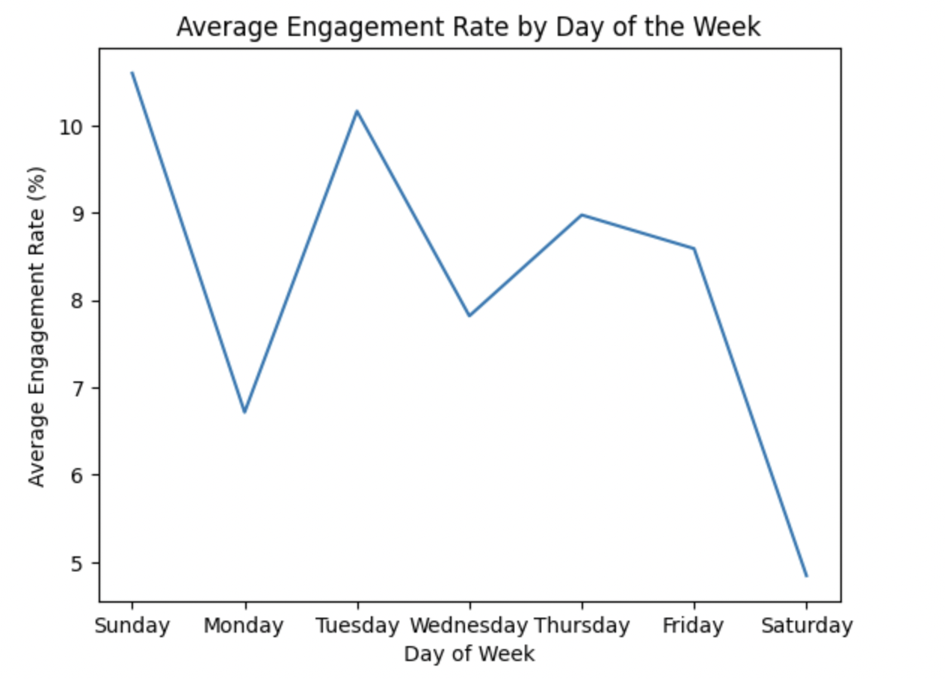
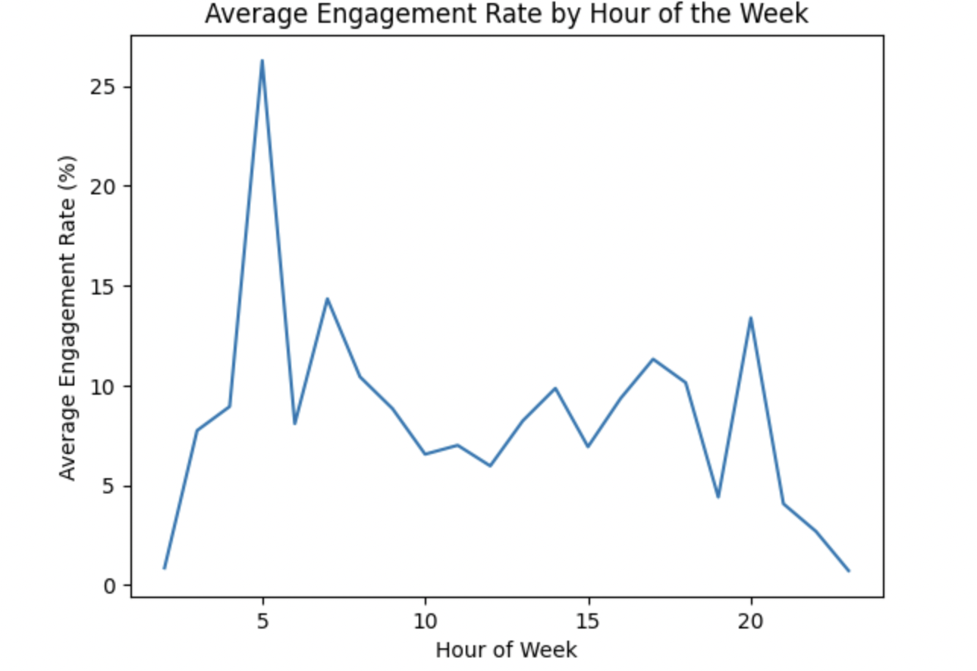
3. Does day of the week and time of posting affect engagement rates?

Slide 9
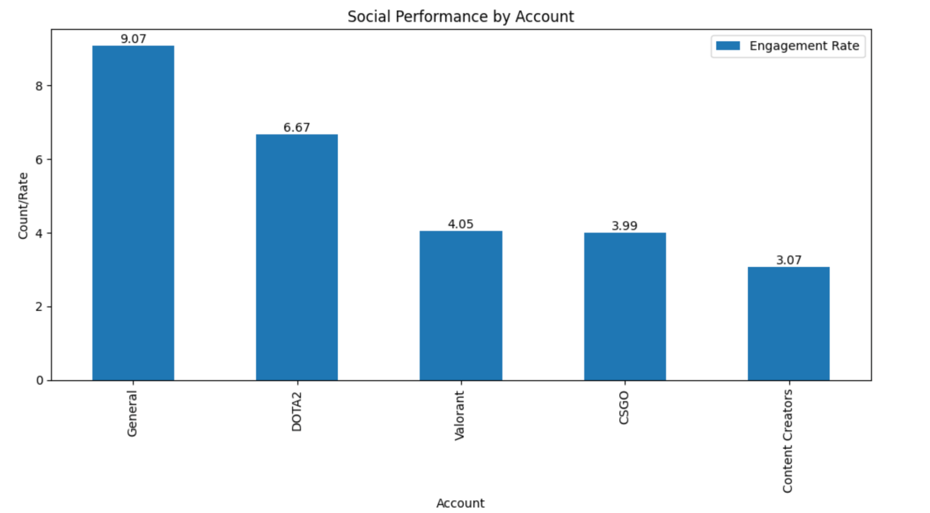
4. How are our game titles doing in terms of social performance? Is there a specific game we should focus more on or less?

Slide 10
Based on the analysis, we should focus more on Valorant and Counter Strike - Global Offensive(CSGO) to increase all three metrics, impressions, engagement and engagement rates.

Slide 11
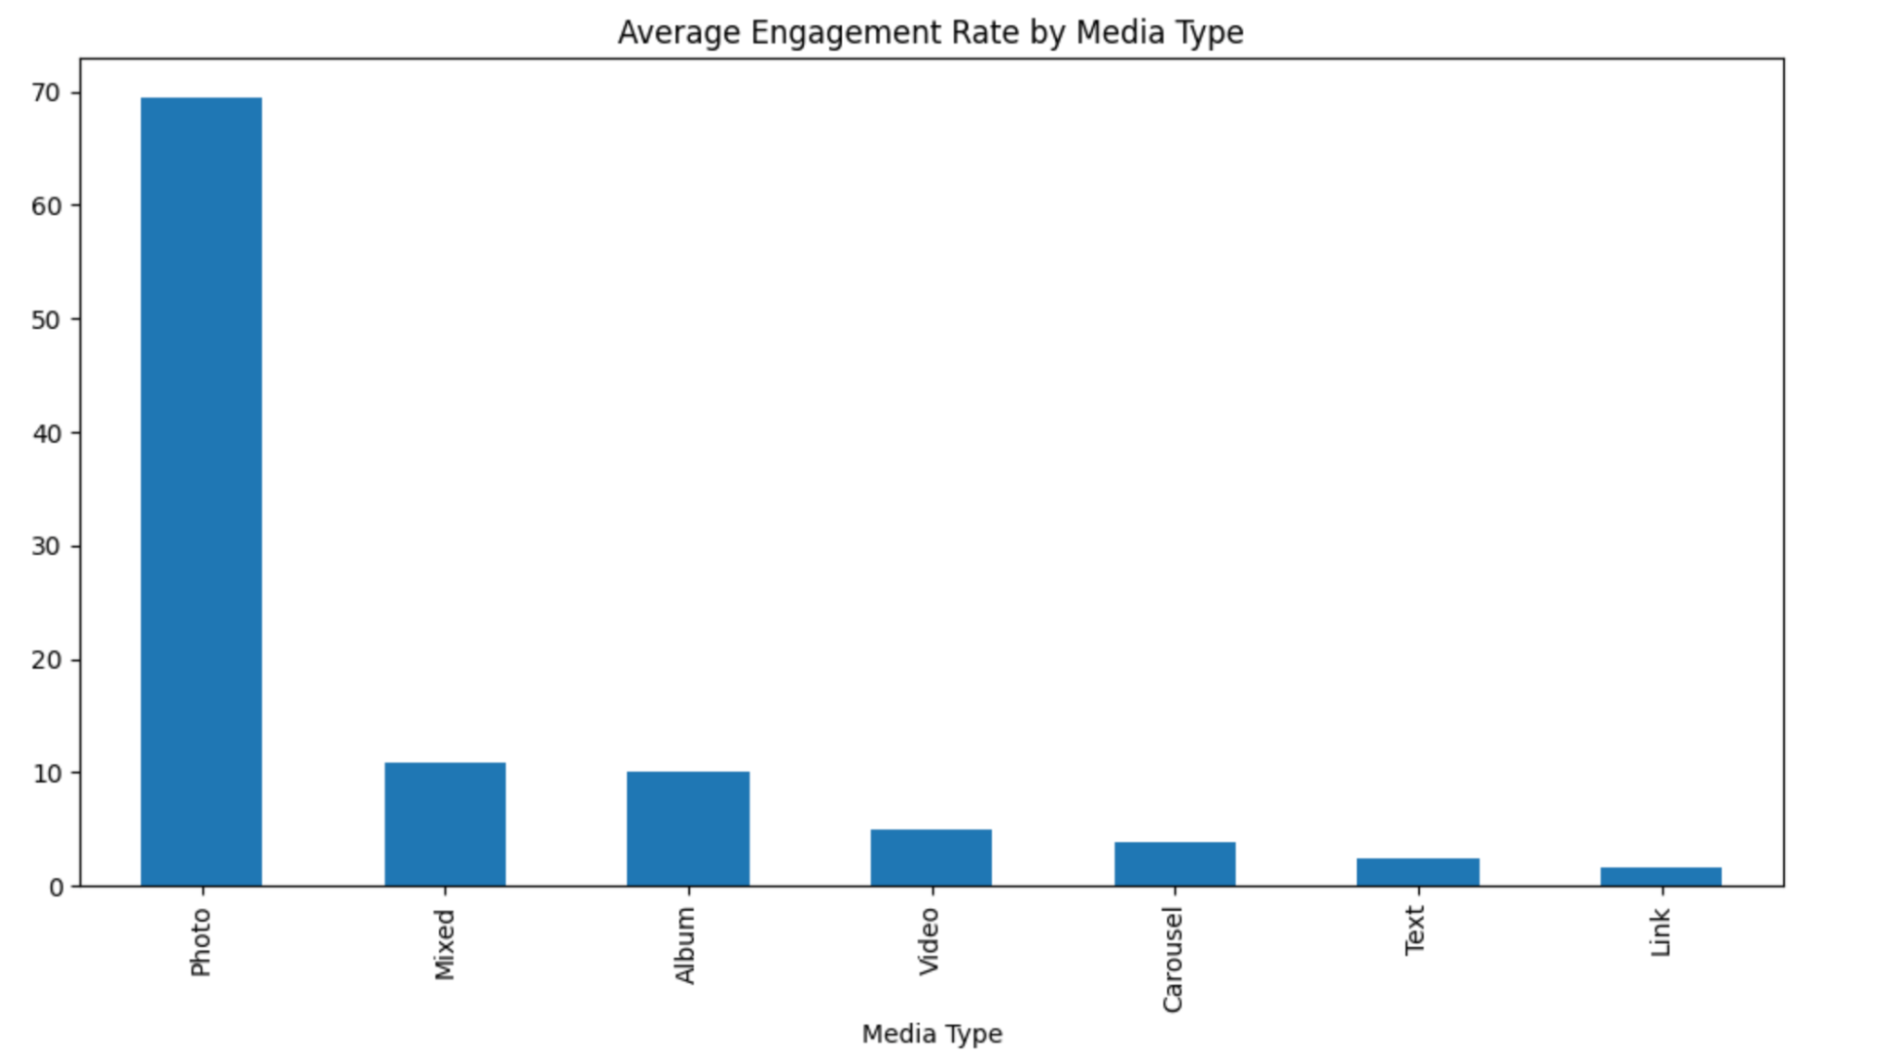
5. What media type performs the best?

Slide 12
Based on the analysis, it turns out that Photo type of media has performed best than all other types of media.

Slide 13
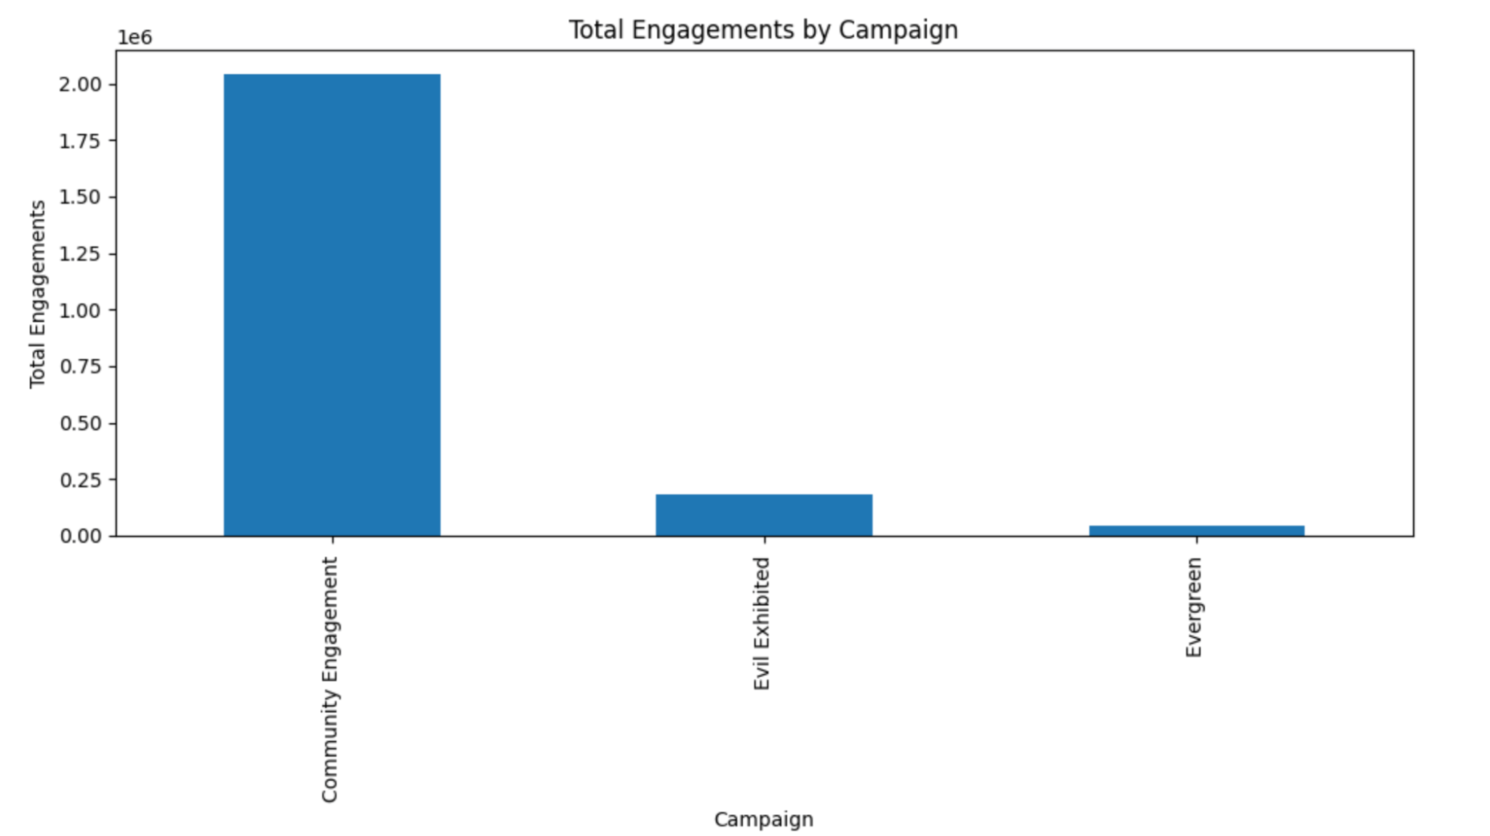
5. What is our best performing campaign?

Slide 14
Based on the analysis, it turns out that Community Engagement type of campaign has performed best.

Slide 15
Posting strategy for Social Channels
Based on my analysis on the dataset so far, it can be deduced that a Photo campaign should be run on Sundays for targeting Community Engagement on Facebook page. There is no visible difference in the timings for Sunday, but we can see a peak between 5pm to 9pm in the evening. Hence, by running our campaign at this time might give us better results.

Slide 16
What suggestions would you give to the social media team if they want to expand their
presence?
Based on my analysis so far, it can be said that Valorant had gained popularity by running video campaigns and that too on Youtube. It can now focus on runnning video campaigns by running them on Facebook page and secondly on Tiktok or Twitter. FB is likely to give 15.06% engagement while tiktok and twitter can be expected to give 5.3% and 5% engagement rates respectively.

